Slide 1
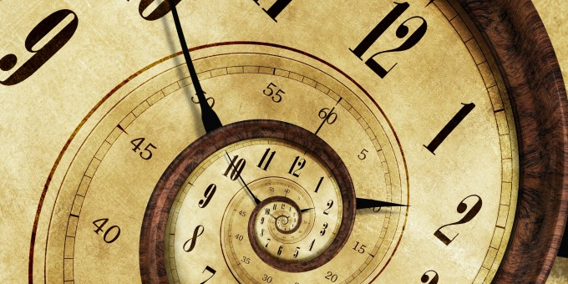

CLOCKS
© Department of Analytical Skills

Slide 2
Table of content
concept of clock
angle computation

Slide 3
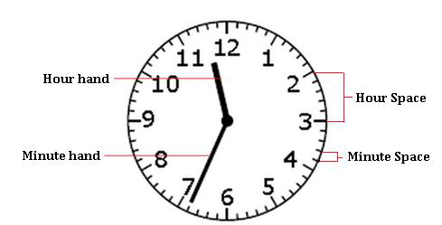
They are usually numbered from 1 to 12 as shown in the figure below.

Slide 4
Hour hand covers an angle of 360° in 12 hours. So, the hour hand in one hour will cover 360 /12 = 30°.
So for every minute, the hour hand moves through 30 /60 = 0.5 °.

Slide 5
Minute hand covers an angle of 360° in 1 hour. So for every minute, the minute hand moves through 360/60 = 6 °.
So, their relative displacement for every minute is 5.5° or 11/2°.

Slide 6

FORMULA TO FIND THE ANGLE BETWEEN THE HANDS OF THE CLOCK:

Slide 7
𝜃=30°𝐻− 11/2𝑀
(when the minute hand is trailing the hour hand)
𝜃=11/2𝑀− 30°𝐻
(when the minute hand is leading the hour hand)
𝜃 = Angle between the hands of the clock

Slide 8
COINCIDENCE OF THE HANDS OF THE CLOCK:
At 12 o' clock, the hands of the clock overlap i.e. the angle formed between them is 0°.
To find the next time they overlap, the gap between them should be 360° so that they are at the same point. Hence it takes,
11/2 × t = 360
t = 720/11 = 65 (5/11) minutes

Slide 9
FREQUENCY OF FORMATION OF ANGLES BETWEEN THE HANDS OF THE CLOCK:
We know that the hands of the clock coincide every 65 5/11 or 720/11 minutes. So, in a day there are 24 × 60 = 1440 minutes.
Therefore, in a day the hands of the clock coincide (1440 × 11) / 720 = 22 times.

Slide 10
Thus, it can be concluded that from 11 to 1 o' clock they coincide only once at 12 o' clock.
So, 11 times in 12 hours and thus 22 times in 24 hours.

Slide 11
PRACTICE QUESTIONS

Slide 12
1. Find the angle between the hands of a clock when the time is 5:40.
80⁰
160⁰
70⁰
120⁰
Ans: C

Slide 13
2. Find the angle between the minute hand and the hour hand of a clock when the time is 7:20. (a) 80⁰
(b) 90⁰
(c) 100⁰
(d) 110⁰
Ans: C

Slide 14
3. The reflex angle between the hands of a clock at 10:25 is
180⁰
162.5⁰
(c) 165⁰
(d) 197.5⁰
Ans: D

Slide 15
4. Find the angle between the hour hand and the minute hand of a clock when the time is 15:25.
47.5 ⁰
45.5 ⁰
50 ⁰
None of these
Ans: A

Slide 16
5. At what time between 5 p.m. and 6 p.m., do the hands of a clock coincide?
(a) 8 hour 29 3/11 min
(b) 9 hour 33 8/11 min
(c) 5 hour 27 3/11 min
(d) None of these
Ans: B

Slide 17
6. The minute hand of a clock is found to cross the hour hand x minutes past three. Find x.
10 5/11
15 15/11
16 4/11
21 9/11
Ans: C

Slide 18
7. The number of minutes from midnight to now is 9 times the number of minutes from now to noon. What time is it now?
10.50 a.m.
(b) 10.48 a.m.
(c) 10.40 a.m.
(d) 10.53 a.m.
Ans: B

Slide 19
8. Find at what time (in minutes) past 8 o' clock but before 9 o' clock will the hands of a clock be in the same straight line but not together.
100/11
(b) 110/11
(c) 120/11
(d) None of these
Ans: C

Slide 20
9. How many times in a day do the hands of a clock form 60⁰?
22
(b) 33
(c) 44
(d) 55
Ans: C

Slide 21
10. A few times per day, the minute hand of a clock is exactly above (or below) the hour hand. How many times per day does this occur?
11 times
(b) 24 times
(c) 22 times
(d) 44 times
Ans: C

Slide 22
11. At how many times between 12 o'clock and 1 o' clock are the minute hand and the hour hand of a clock at an angle of 90 degrees to each other?
4
(b) 6
(c) 3
(d) 2
Ans: D

Slide 23
12. How much does a watch gain per day, if its hands coincide every 64 minutes?
32 8/11 min
(b) 36 5/11 min
(c) 90 min
(d) 96 min
Ans: A

Slide 24
13. How many minutes is it until six o’clock if fifty minutes ago it was four times as many minutes past three o’clock?
26 min
(b) 27 min
(c) 30 min
(d) None of these
Ans: A

Slide 25
14. A man who went out between 3 and 4 and returned between 8 and 9, found that the hands of the watch had exactly changed places. When did he return?
14 min past 8
(b) 21 1/3min past 8
(c) 19 2/3 min past 8
(d) 18 6/13 min past 8
Ans: D

